Slide 1
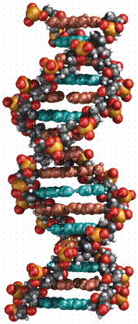
Genetics by Dr Shuzan Aly Lecturer of Medical Biochemistry

Slide 2
The Central Dogma of Molecular Biology

Slide 3
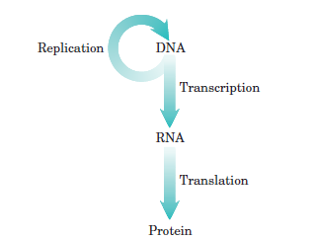

Slide 4
The structure of DNA and RNA
Genetic material of living organisms is either DNA or RNA (polynucleotides).
Difference | DNA | RNA
Name | Deoxy-ribo-nucleic a | Ribo-nucleic a
Sugar | Deoxyribose | Ribose
Strand | Double | Single
Bases | A, G, C, T | A, G, C, U
Types | One type | Several
Main Site | Nucleus | Cytoplasm

Slide 5
Structure of a nucleotide
Three components:
A Pentose sugar
(5 carbons)

Slide 6
Structure of a nucleotide
A Phosphate group

Slide 7
Structure of a nucleotide
A Nitogenous base

Slide 8
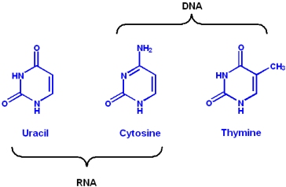
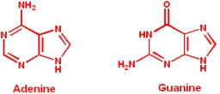
The Bases
PYRIMIDINES
PURINES

Slide 9
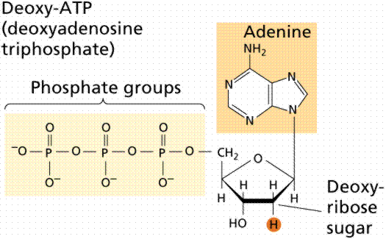
Adenine

Slide 10
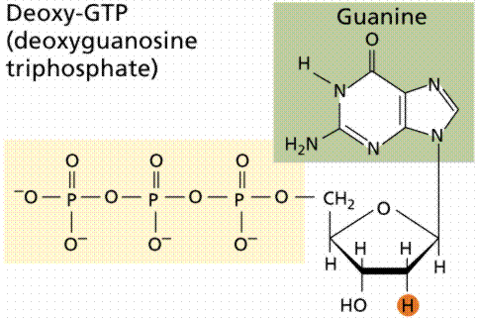
Guanine

Slide 11
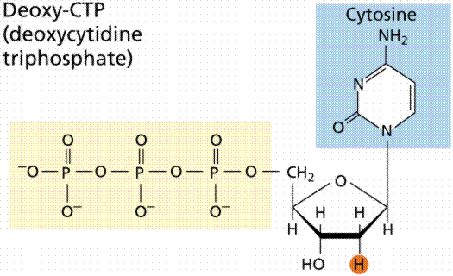

Slide 12
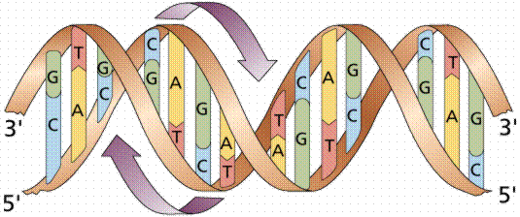
Base pairing
The Nitrogenous bases of one strand of DNA base pair with the bases on the opposite strand of the DNA.

Slide 13
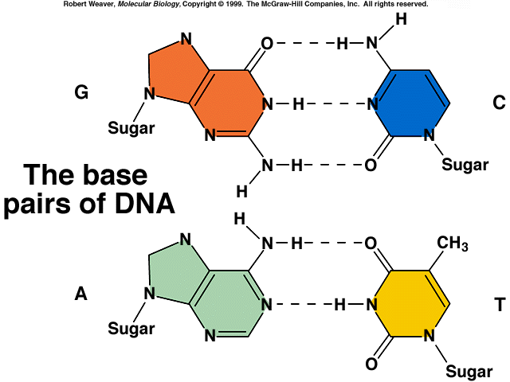
DNA Stabilization (Complementary Base Pairing)
G≡C
A=T
A=U
Notes:
Point out purines and pyrimidines. Note how the width can be maintained by the pyrimidine/purine pairing .

Slide 14
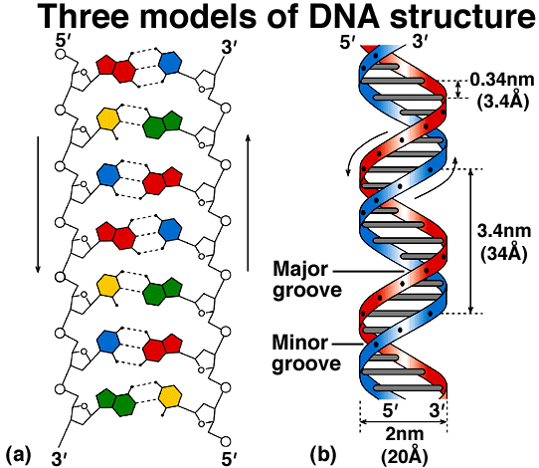

Slide 15
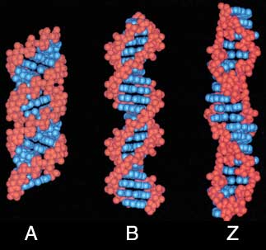
Comparison of A, B and Z forms of DNA
A: right-handed, short and broad, 11 bp / turn
B: right-handed, longer, thinner, 10 bp / turn
Z: left-handed, longest, thinnest, 12 bp / turn
Other forms of DNA: C, D, E and P

Slide 16
Denaturation and Renaturation
Heating DNA can overcome hydrogen bonds and cause the strands to separate (DNA Denaturation)
When cooled relatively weak hydrogen bonds between bases can reform (DNA renaturation)
Thus higher GC content is reflected in higher melting or denaturation temperature

Slide 17
BEST WISHES

